Slide 1
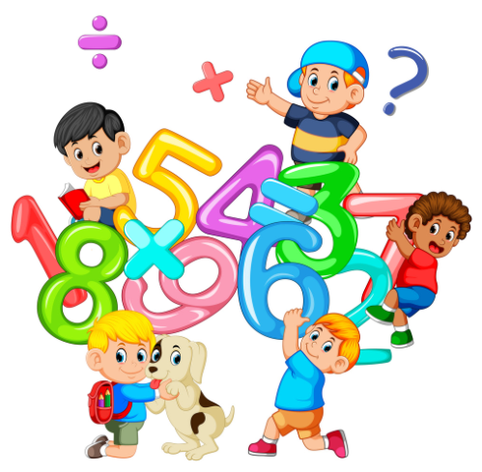
Welcome to a fun number session!
Notes:
While parents come in

Slide 2
Maths Workshop
Delivered to you by Mrs Crick & Mr Hussain
Notes:
JC

Slide 3
Aims of Maths National Curriculum:
Fluency
Problem solving
Reasoning
Notes:
JC
The national curriculum is a set of subjects and standards used by primary and secondary schools so children learn the same things.
More details about this later.

Slide 4
Questions
There are post-it notes on your tables
If you have a question throughout this evening, please ask, or jot it down on a post-it note and we will endeavour to answer it at the end.
Notes:
JC
Ask a question, however small you feel it is.

Slide 5
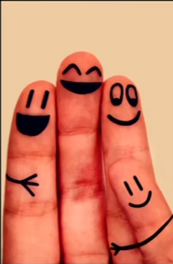
We can all do maths.
https://www.youtube.com/watch?v=3icoSeGqQtY
Teachers, TAs, family members and members of the wider society have a responsibility to aim high for every child.
Notes:
JC
Jo Boaler – English working in America Show video from 30 seconds to 2 minutes 30 seconds
We all have a responsibility to aim high for every child.
Be positive about maths.

Slide 6
Every child – across all abilities – can succeed at mathematics
Notes:
JC
Every child – across all abilities – can succeed at mathematics
We need to model this.
Be positive about maths.

Slide 7
At least 65% of the maths your child will undertake at school will be reasoning, application or problem solving.
Notes:
JC
At least 65% of the maths your child will undertake at school will be reasoning, application or problem solving.
Books will not have pages of calculations – it will be contextual.
2/3 of it will be contextual.

Slide 8
Aims of Maths National Curriculum:
Children become fluent in the basics of maths.
Number bonds
Times tables (multiplication and division)
Multiplying and dividing by 10, 100, 1000
2D shapes / 3D shapes + properties
Conversion facts
Notes:
JC
Children become fluent in the basics of maths. Have instant recall.
Number bonds
Times tables (multiplication and division)
Multiplying and dividing by 10, 100, 1000
2D shapes / 3D shapes + properties
Conversion facts
Embedded - the ability to recall and apply knowledge rapidly and accurately.

Slide 9
Reason mathematically
Justify why they believe something is true
Prove that what they are saying is correct
…And do all of the above using the correct mathematical language
Notes:
JC
Children can reason mathematically.
Justify why they believe something is true
Prove that what they are saying is correct
…And do all of the above using the correct mathematical language / vocabulary.

Slide 10
Can solve problems by applying their mathematics to a range of straight forward and more complex problems
Break down problems into simple steps
Persevere to find the answer
Notes:
JC
Can solve problems by applying their mathematics to a range of straight forward and more complex problems
Break down problems into simple steps
Persevere to find the answer
When they find non-routine questions – have the confidence and strategies to have a go

Slide 11
Place value
Place value is where the position of a digit within a number defines it’s value.
So the place of the 2 in the string of 629 tells us it has a value of 2 tens, which is 20.
Notes:
JC
Place Value is so important.
Place value = A short hand description signalling that the place (position) of a digit within a string of digits indicates its value.
So the place of the 2 in the string of 629 tells us it has a value of 2 tens = 20
Sound understanding of place value is needed to:
Compare numbers and put them in order
Partition numbers e.g 73 = 70 + 3 = 60 +13
Calculate with numbers

Slide 12
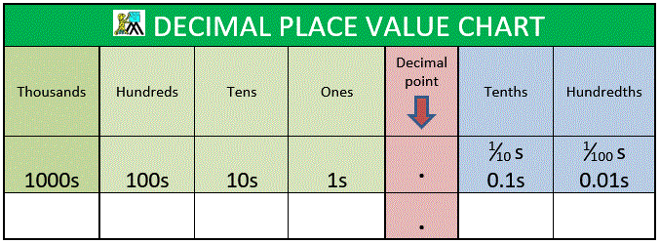
Place value
Notes:
JC

Slide 13

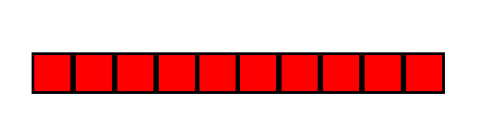
Using the resources please make 25
Notes:
JC
Dienes – named after Zoltan Dienes
Keep your 25 for later.

Slide 14
Now make 47
Notes:
JC

Slide 15
Now make 47
Notes:
JC
Keep 47 for later

Slide 16
Principle of exchange
The number we call ‘ten’ (10 in numerals) is the most important in our naming system because when we are counting collections, as soon as we have a group of ten we call them something else.
So
Ten ones are called one ten
Ten tens are called one hundred
Ten hundreds are called one thousand.
Notes:
JC

Slide 17
Addition and Subtraction
Notes:
JC

Slide 18
25 + 47
Notes:
Jackie
RH to do written column method

Slide 19
25 + 47
Notes:
JC
Combine
How many ones?

Slide 20
25 + 47
Notes:
JC
Exchange 10 ones for 1 ten 72

Slide 21

25 + 47
tens | ones
2 | 5
4 | 7
Notes:
JC
Introduce chn to column method – one number underneath another number. Line up the Os Ts Hs

Slide 22
25 + 47
tens | ones
2 | 5
4 | 7
Notes:
JC

Slide 23
25 + 47
tens | ones
2 | 5
4 | 7
Notes:
JC
Once understood – apply to calculating with 100s, 10s and 1s

Slide 24
Subtraction
Notes:
JC
RH to show the written method of subtraction

Slide 25
72 - 47
Please get out the apparatus you will need to solve this calculation.
Notes:
JC
Read the calculation:
Take away
Subtract
Minus
Less than
Difference between
Fewer than

Slide 26
72 - 47
Notes:
JC
Only need 72
How can we take 7 away?
Rename / regroup / exchange 1 ten for 10 ones

Slide 27
72 - 47
Notes:
JC
70 + 2 = 60 + 12 (place value)
Now we have 12 ones, we can subtract 7 ones from it.

Slide 28



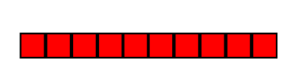
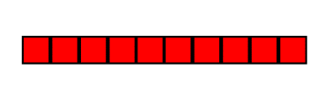

72 - 47
tens | ones
7 | 2
4 | 7
Notes:
JC
Written method

Slide 29
72 - 47
tens | ones
7 | 2
4 | 7
Notes:
JC

Slide 30
72 - 47
tens | ones
7 | 2
4 | 7

Slide 31
72 - 47
tens | ones
7 | 2
4 | 7
Notes:
JC
Left with 25

Slide 32
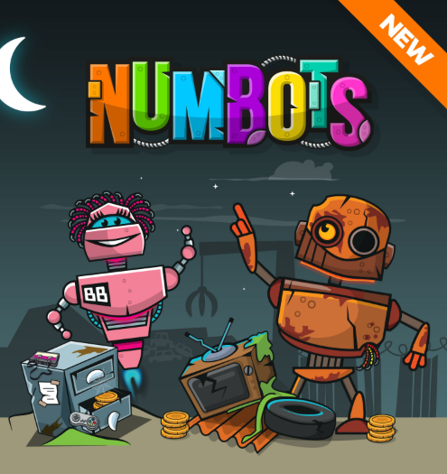
Notes:
JC
NumBots is an online game and playing little and often will significantly improve your child’s recall and understanding of number bonds and addition and subtraction facts. These are critical foundations in maths.
Computers, ipads, tablets, phones, etc.

Slide 33

Every child has been provided with a login and a password.
It is the same login and password for Times Tables Rockstars and Numbots.
Notes:
JC

Slide 34
Multiplication and Division
Notes:
RH

Slide 35
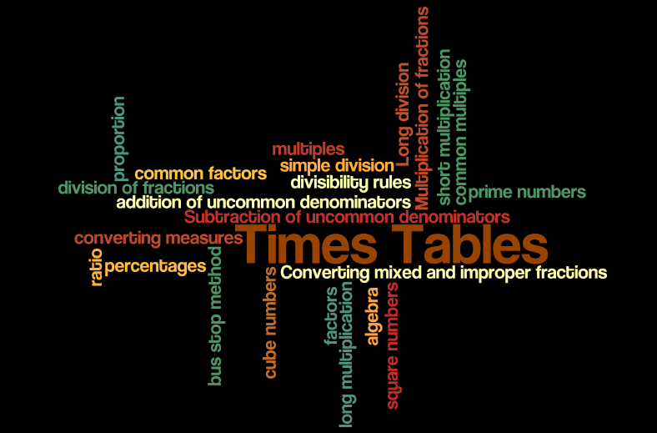
Times Tables
Notes:
JC
Times tables are one of the most important areas of maths.

Slide 36
Exploring arrays
Notes:
RH

Slide 37
3 x 4 4 x 3
Notes:
JC
3 groups (columns) of 4
4 groups (columns) of 3

Slide 38
Without times table knowledge, children cannot:
Find division facts
Simplify fractions
Work out ratios
Find out the area of a garden space
Find out the volume of a liquid
Double the ingredients for a recipe
Finding the price of multiple purchases
Notes:
JC
If you don’t know your times tables you can not access…
Times Tables, simple division, bus stop division method, Long division, addition and subtraction of fractions with different denominators, Converting mixed and improper fractions, Multiplication and division of fractions, ratio, proportion, algebra, prime numbers, square numbers, multiples, factors, cubed numbers, percentages, long multiplication, short multiplication, converting measures, common multiples, common factors and divisibility rules.
They are interwoven into many areas of Mathematics:

Slide 39
Times Tables
Year Group | Expectation
Year 1 | Count in multiples of 2, 5 and 10. Recall and use doubles to 10 and corresponding halves.
Year 2 | Recall and use multiplication and division facts for the 2, 5 and 10 multiplication tables, including recognising odd and even numbers
Year 3 | Recall and use multiplication and division facts for the 3, 4 and 8 multiplication tables
Year 4 | Recall multiplication and division facts for multiplication tables up to 12 x 12
Year 5 and 6 | Children are expected to already be fluent in their multiplication and division facts
Notes:
RH
The expectation is that by the time your children have left Year 4 they will know all their multiplication and division facts, at speed. (INSTANT RECALL)
They should only revisited in Year 5 and 6 through special numbers (factors, multiples, prime, cube and square).

Slide 40
From June 2020 every year 4 child will be tested on their multiplication facts and the expectation is that they will score 100%!
Notes:
JC
The government mandatory test in June this year. The test will be taken by all children in Year 4.

Slide 41

Notes:
RH

Slide 42
Every child has been provided with a login and a password.
It is the same login and password for Times Tables Rockstars and Numbots.
Notes:
RH

Slide 43
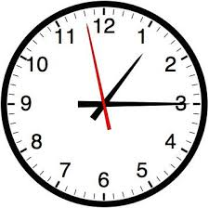
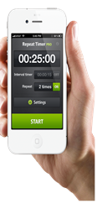
Home Activities
Time
Recognise numbers on a clock.
What time is it?
Ask them questions related to time.
Use timers, phones, clocks to measure periods of time.
Timetables at bus stops
Counting
Notes:
JC
How to help your child at home
Recognise numbers on a clock.
What time is it?
Ask them questions related to time.
Use timers, phones, clocks to measure periods of time.
Timetables at bus stops
Counting

Slide 44
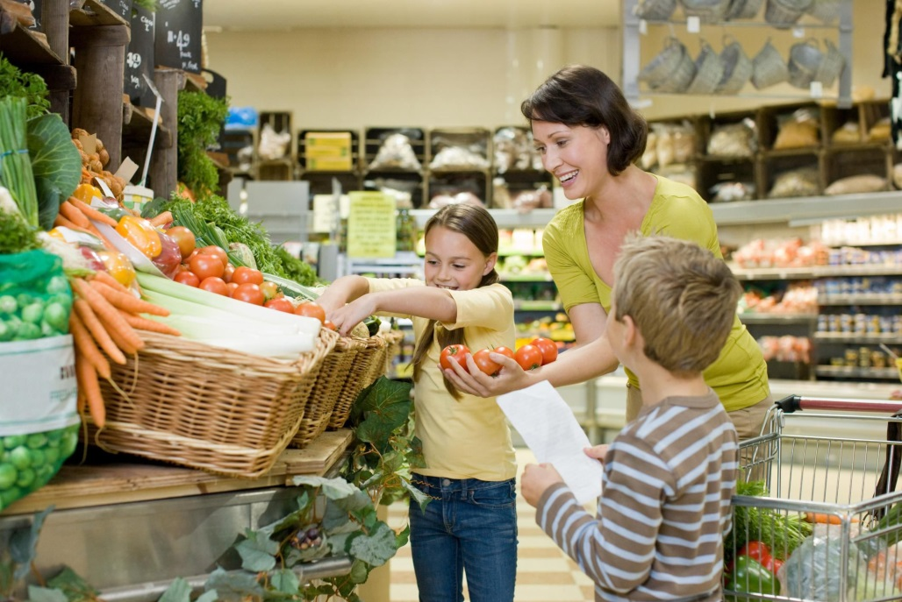
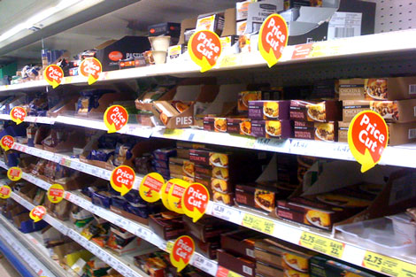
Going shopping:
Reading price tags
Counting items into a basket
Mentally adding items to total the cost
Finding and counting out coins and calculating change
Allow children to have experience of handling money in real life situations
Comparing weights - which is heavier?
How much do items now cost after a price cut?
Notes:
JC
Going shopping:
Reading price tags
Counting items into a basket
ESTIMATING
Mentally adding items to total the cost
Finding and counting out coins and calculating change
Allow children to have experience of handling money in real life situations
Comparing weights - which is heavier?
How much do items now cost after a price cut?

Slide 45
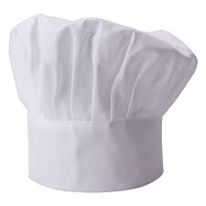
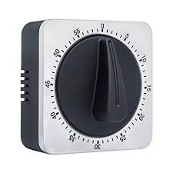
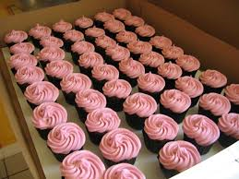
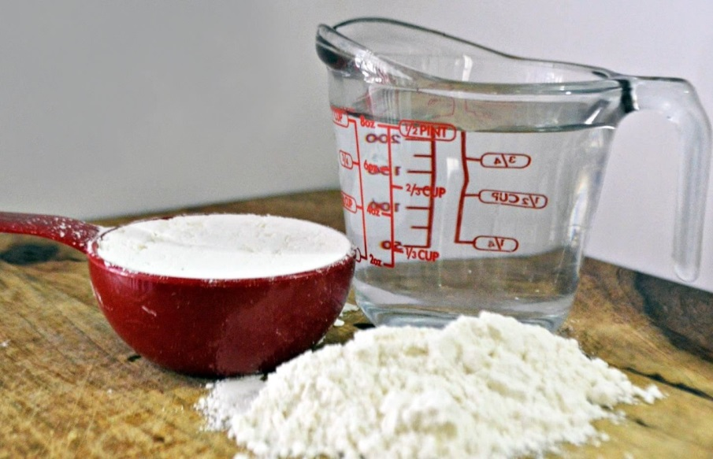
Cooking / Baking
Measuring
Weighing
Timing
Multiplication and division e.g. cupcakes in rows.
Notes:
RH
Measuring
Weighing
Timing
Multiplication and division e.g. cupcakes in rows / making arrays
Increasing the amount by double / halving the ingredients

Slide 46
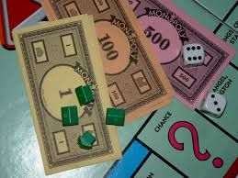
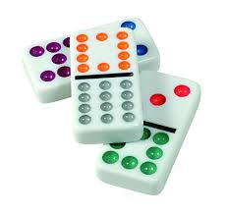
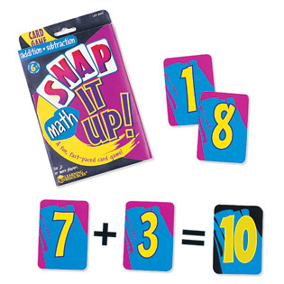
Counting
Number bonds to 10 and 20
Play board games
E.g. Dominoes, Monopoly, Snakes and Ladders
Numbots
Maths card games
Notes:
JC
Number bonds to 10 and 20
Play board games
E.g. Dominoes, Monopoly, Snakes and Ladders
Numbots
Maths card games

Slide 47
Reflect
What did you find interesting?
What was useful?
What are you going to try with your child in the next week?
Notes:
JC

Slide 48
Any questions?
Notes:
RH

Slide 49
Thank you.
We will now hand over to Mrs Bowman
Notes:
RH & JC
Thank you for coming.
Do you have any questions?

