Slide 1
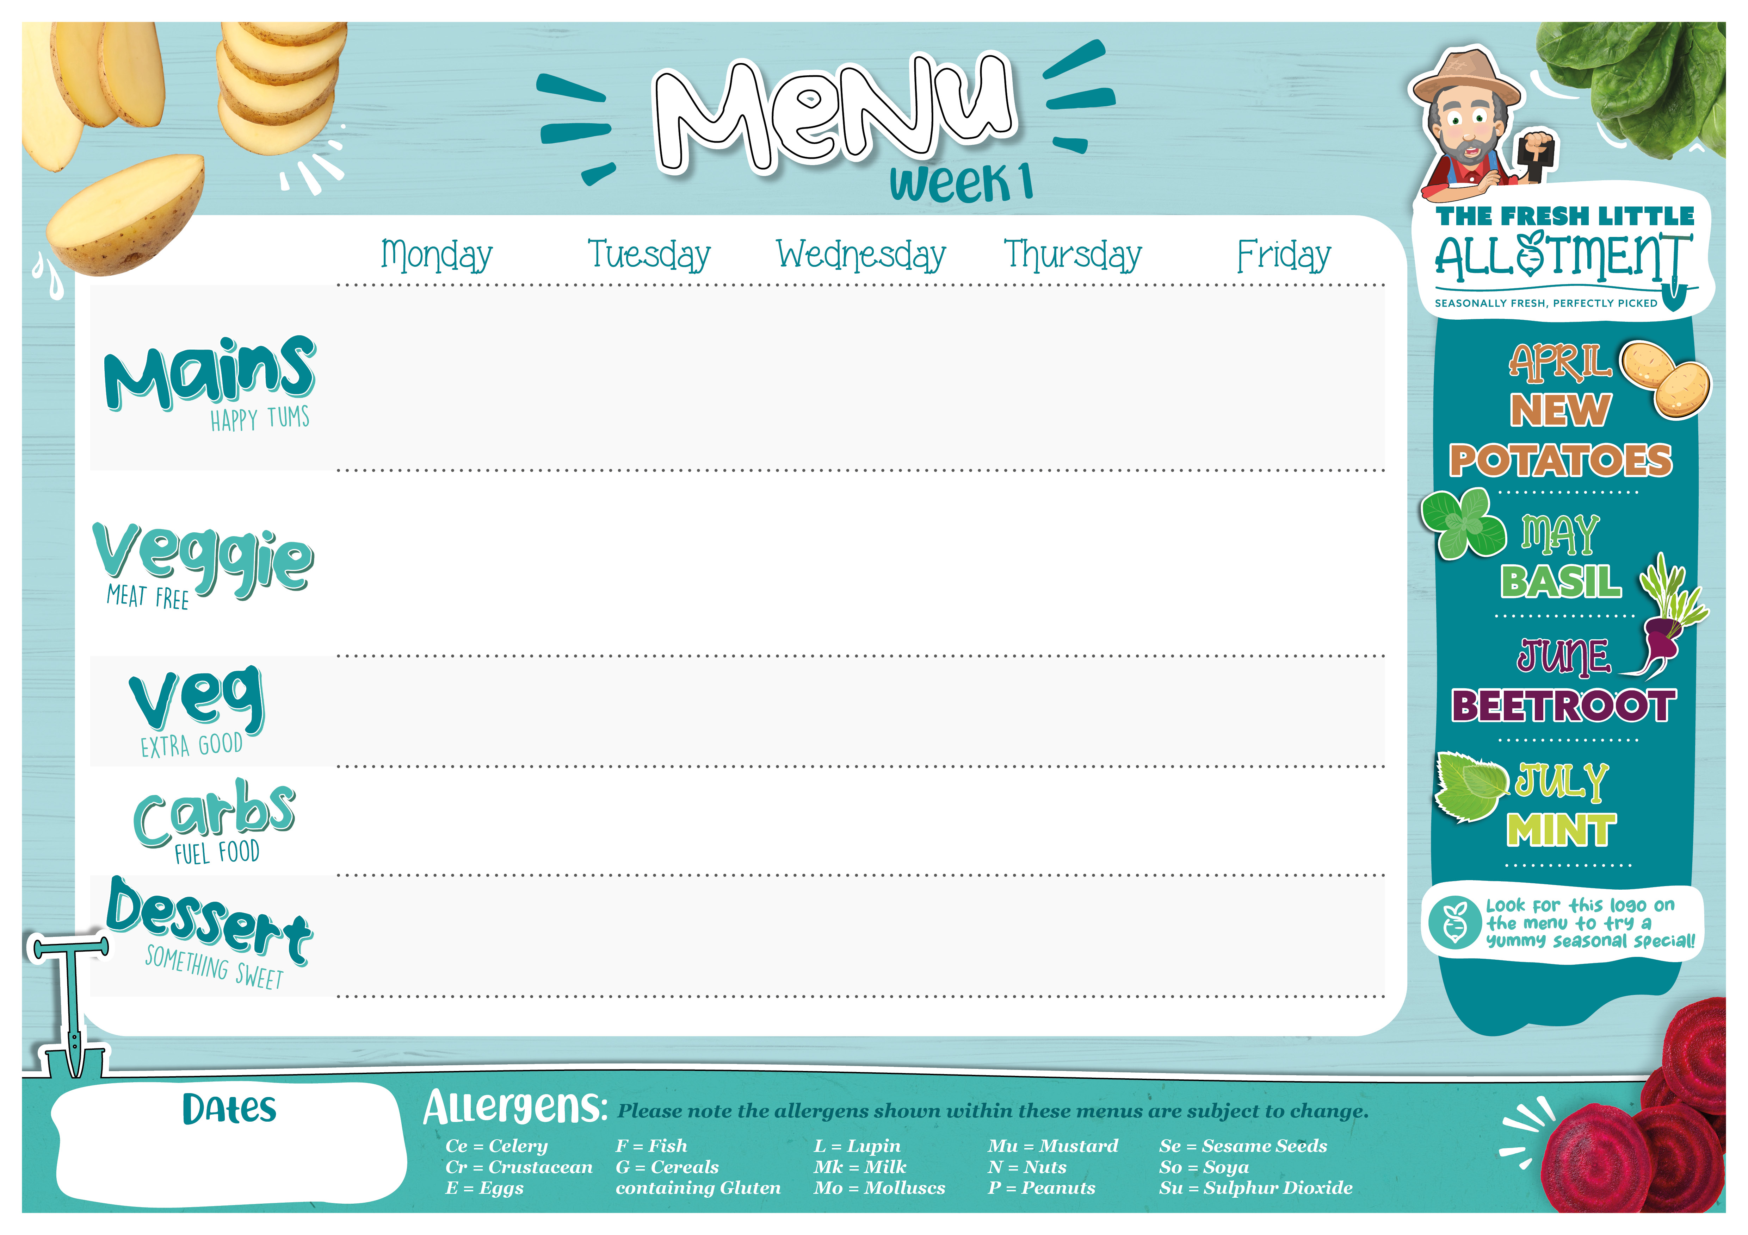

Butter Chicken Curry with Tomato and Mint Sambal (Mk,So) | Pepperoni Pizza (G,Mk) | Roast Gammon with Gravy | Pasta Bar (G) Beef Bolognese Tomato sauce | Fish Fingers with Tomato Sauce (G,F)
Chickpeas Braised in Butter Curry with Tomato and Mint Sambal (Mk,So) | Margherita Pizza (G,Mk) | Quorn Roast with Gravy (E,Mk) | Pasta Bar (G) Vegan Bolognese Tomato sauce | Vegetable Fingers (G)
Sweetcorn Cauliflower | Coleslaw (E) | Cabbage Carrots | Olives Cheese (Mk) | Peas Baked beans
50/50 Rice | Potato Wedges | Roasted New Potatoes | Parsley and Mint Focaccia (G) | Chips
Fruity Jelly or Fresh Fruit Platter | Beetroot Chocolate Cake (G,E,Mk,So) | Ice Cream (Mk) | Peach Crumble (G) | Banana Raisin Cookie (G,E)
Jacket Potatoes, ‘Allergen Free’ Salad Bar, Cold Desserts and Fresh Fruit are available daily.
13/0,4/05,1/06,22/06, 13/07

Slide 2

Chicken Macaroni Pasta (G,Mk,So) | Lamb and Eat Curious Tacos (Mk) | Toad in the Hole with Gravy (G,E,Mk,Su) | Jacket Potato Bar: Lamb Chilli , Baked Beans, Pepperoni and Cheese (Mk,Mu,So) | Fish Fingers with Tomato Sauce (G,F)
Macaroni and Cheese (G,Mk,Mu) | Vegan Mince and Eat Curious Tacos (Mk) | Vegetable Sausage Toad in the Hole with Gravy (G,E,Ce,Mk) | Jacket Potato Bar: Baked Beans and Cheese (Mk) Margherita (Mk) Tuna /Mayo (F,E) | Vegetable Fingers (G)
Sweetcorn | Broccoli Green Beans | Cauliflower Carrots | Coleslaw (E) Sweetcorn | Peas Baked beans
Beetroot Focaccia (G) | Mexican Rice Basmati rice | Mashed Potato (Mk) |  | Chips
Shortbread Biscuit (G,E) Fresh Fruit Platter | Banana Flapjack (G) | Fruit Jelly | Vanilla Biscuit with Chocolate Sprinkles (G) | Pineapple and Carrot Cake (G,Mk)
Jacket Potatoes, ‘Allergen Free’ Salad Bar, Cold Desserts and Fresh Fruit are available daily.
20/04,11/05,8/06,29/06

Slide 3

Chicken Meatballs in Tomato Sauce | Lamb Keema Pitta (G,Mk,So) | Roast Chicken, With Gravy (None) with Yorkshire Pudding (G,E,Mk) | Pepperoni Pizza (G,Mk) | Fish Fingers (G,F)
Plant Balls in Tomato Sauce (So) | Pita Pockets with Chickpeas (G,Mk,So) | Quorn Roast (E,Mk) | Margherita Pizza (G,Mk) | Vegetable Fingers (G)
Sweetcorn | Tomato and Onion Salad (Su) Broccoli | Roasted Carrots Green Beans | Sweetcorn | Peas Baked beans
Wholemeal Penne (G) | Sweet Potato Roasties | Roast New Potato | Potato Wedges | Chips
Oat and Orange Cookie (G,E) Fresh Fruit Platter | Pineapple and Raspberry Cake (G,E,Mk) | Fruit Jelly | Ice Cream (Mk) | Iced Sponge Cake (G,E,Mk)
Jacket Potatoes, ‘Allergen Free’ Salad Bar, Cold Desserts and Fresh Fruit are available daily.
27/04,18/05,15/06, 6/07

